Slide 1
Search Engine

Slide 2
Why build a Search Engine?
All available search engines manage user interest automatically, while this reduces the information overhead to manage user interests, we believe that letting users select their own topics.
The main reason every other search engine uses automatic tracking of user behaviour to narrow their search results is that they profit from using user data to show specific advertisements, still after years of managing the sites they fail to even achieve this as users are overloaded with advertisements to the point of diluting the effects of advertisements
Our search engine has a massive advantage where user can narrow their search results themselves.

Slide 3
Unique Selling Point
The greatest difference between other search engines and our search engine is the ability to customize user data by the users themselves as we believe they themselves know what is best result for them.
Using vector search algorithm lets users select relatively similar words / keywords and we handle the rest.

Slide 4
Tech Stack Used
Web Crawling: Python.
Filtering Data: Python, Beautiful Soup.
Vector Search: Python.
Indexing: Python.
Front-End: Flask.
Back-End: Flask.
Database: SQL.

Slide 5
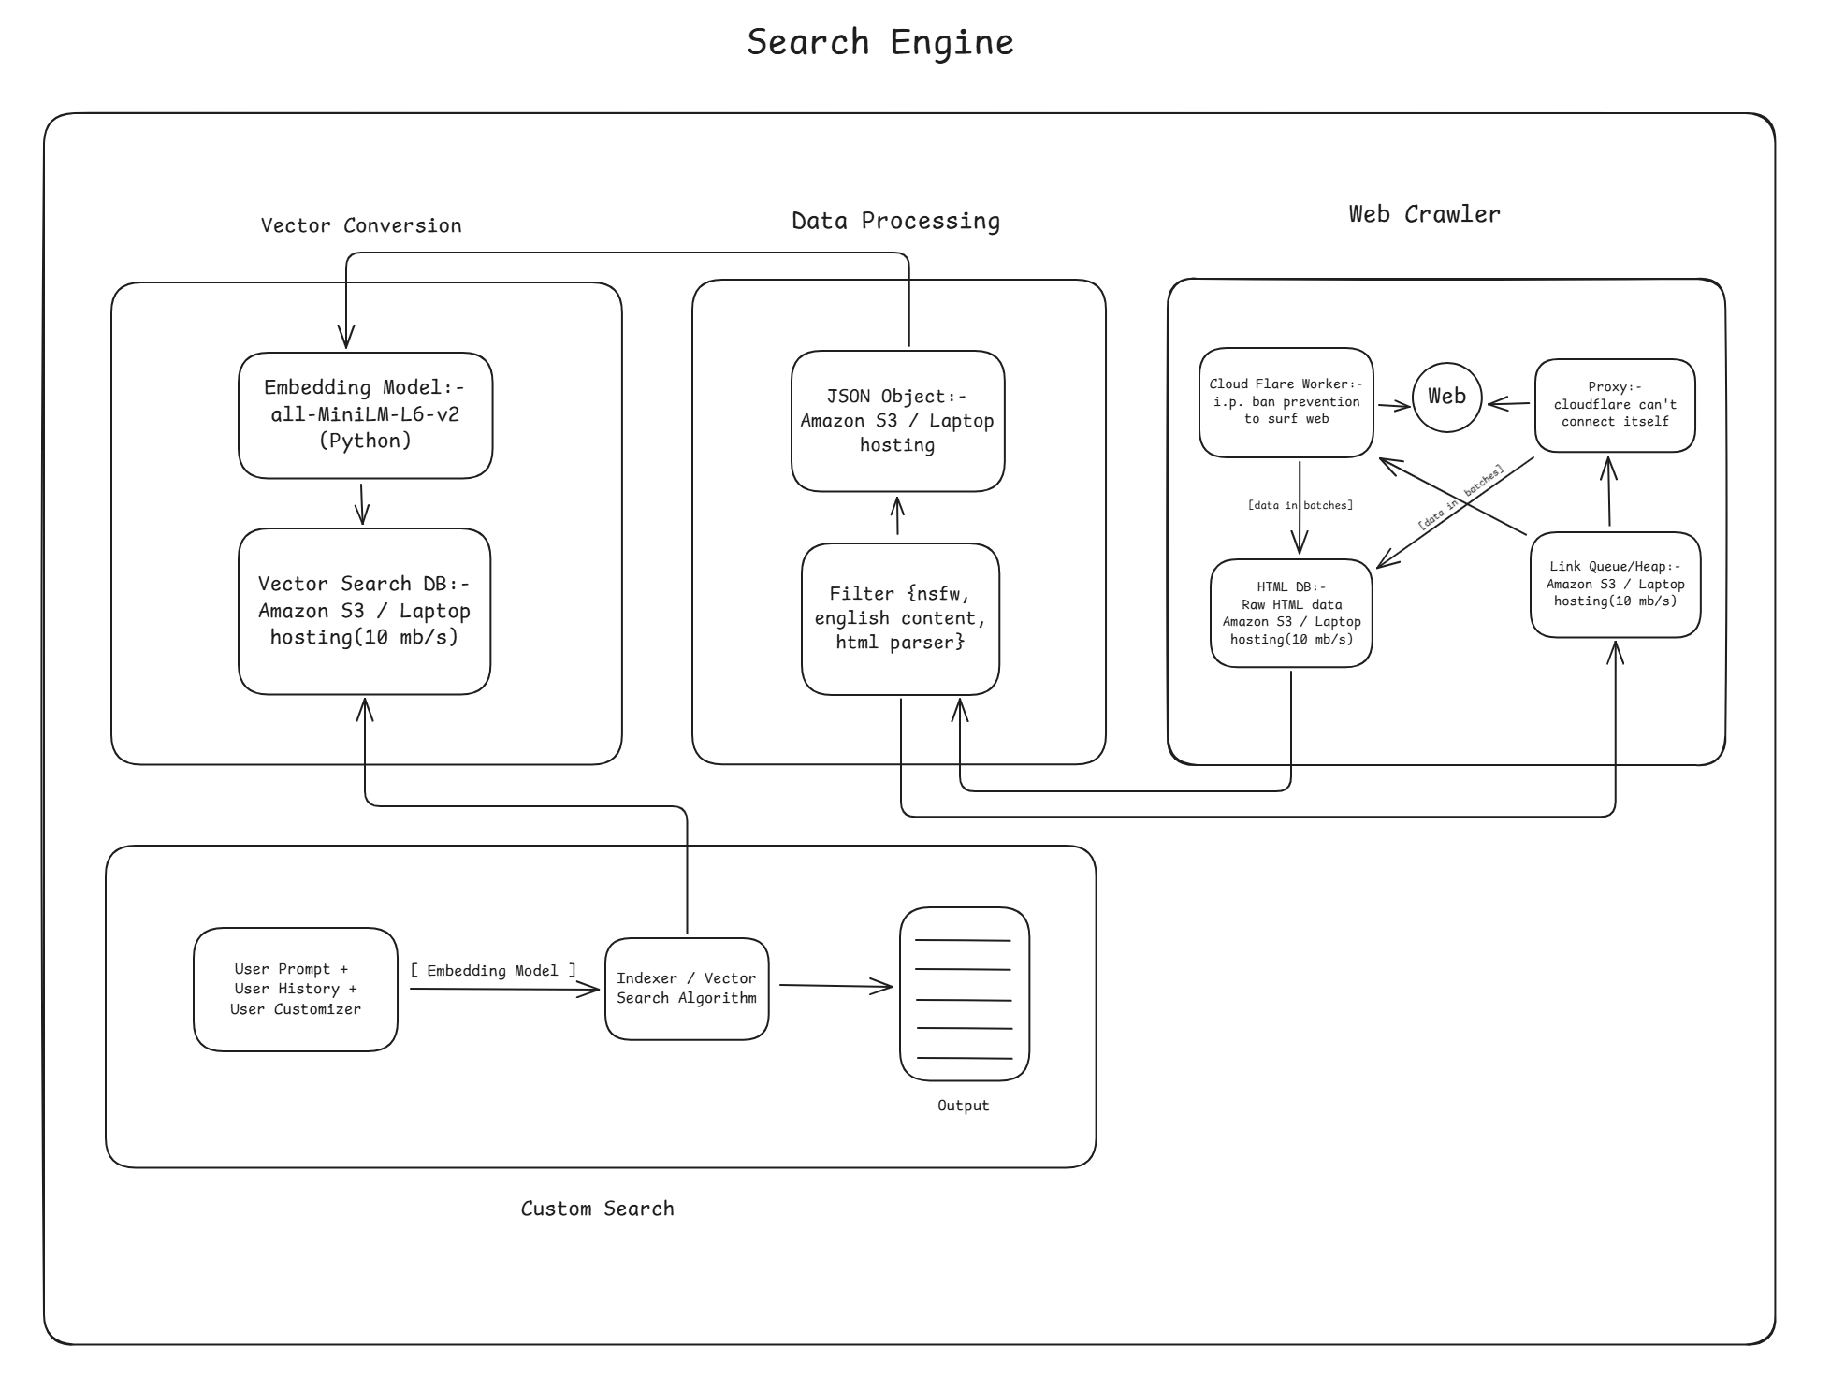
Project Blueprint

Slide 6
Outcomes
Possible patent or Open source project dependent on scale of project.

